Slide 1
Analyzing HCM Real Estate market with Data Sciences tool
Quan Hai Nguyen

Slide 2
Objective of the study
Data Sciences gain more and more attention of the software community with the development of cloud computing, deep learning. Some questions to newbies include: how can data science tools solve a specific problem, how to use and learn it.
Those are things that we want to discover via a sample project: Understand HCM real estate market in recent years via data sciences tools ?

Slide 3
Agenda
Data Sciences Overview
Real Estate project: questions to answers
Data Collection, Preparation
Insights through Data Analysis and Data Visualization
Forecasting Problems
Summerize

Slide 4
Agenda
Data Sciences Overview
Real Estate project: questions to answers
Data Collection, Preparation
Insights through Data Analysis and Data Visualization
Forecasting Problems
Summary

Slide 5
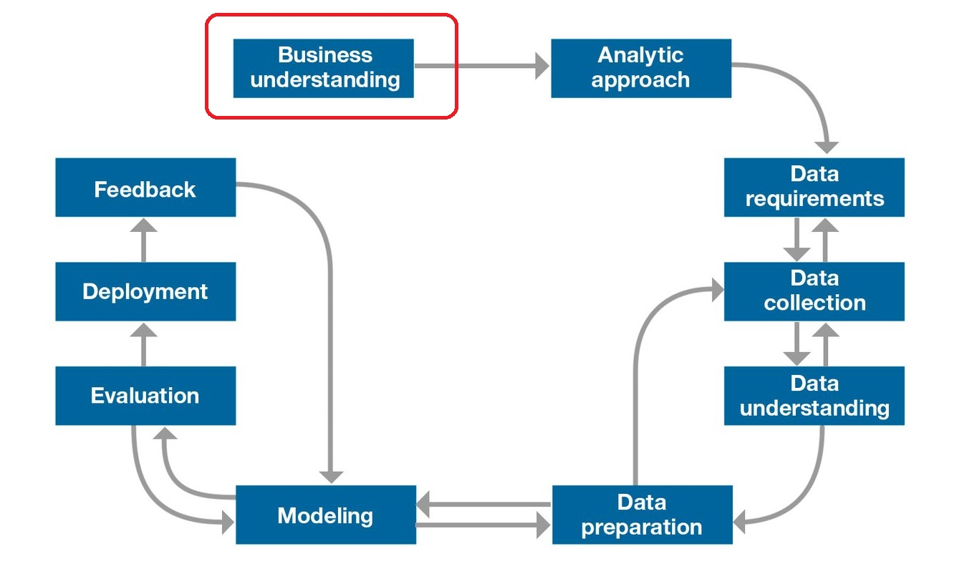
Data Science Overview

Slide 6
Environment for Data Sciences Project
Python
Jupyter Notebooks
Anaconda: environment for Data Sciences project
Run local
Google Colab
Free GPU/TPU machine
Jupyter Notebooks, Python, sharing

Slide 7
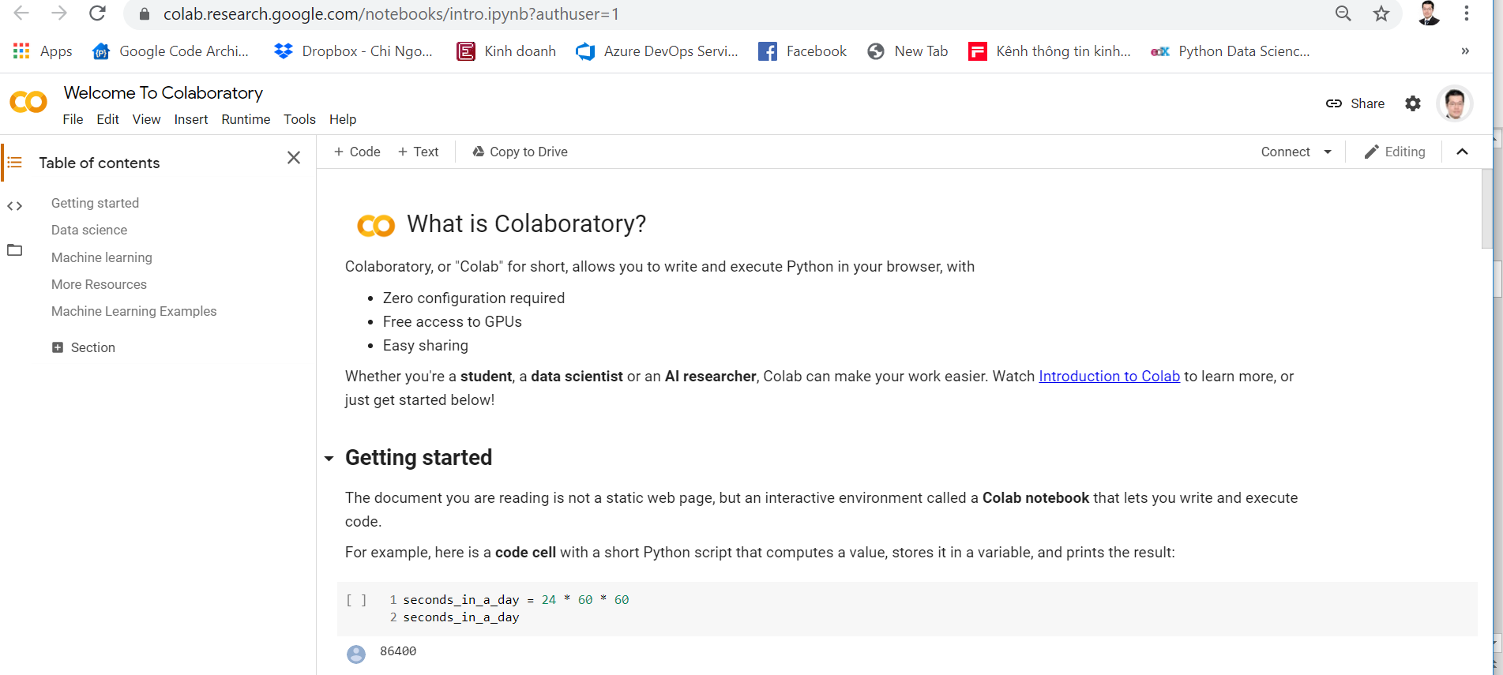
https://colab.research.google.com/

Slide 8
Agenda
Data Sciences Overview
Real Estate project: questions to answers
Data Collection, Preparation
Insights through Data Analysis and Data Visualization
Forecasting Problems
Summary

Slide 9
Real Estate project for HCM market
Data Sciences Real estate projects
California Housing Prices, Boston Housing Price…
Questions include:
What is the price now ?
What is the trend ?
Can we forecast price, place with potential growth ?
What data we have ? What data we need more ?
Which place is good for living ? Studying ? Working ?
What about the traffic, about pollution, services, people living there ? Community for building better place/ culture ?

Slide 10
Agenda
Data Sciences Overview
Real Estate project: questions to answers
Data Collection, Preparation
Insights through Data Analysis and Data Visualization
Forecasting Problems
Summary

Slide 11



Collecting & Pre-Processing data
We collect from real estate news website
Exam: for D9,HCM,
Need to pre-process:
Price/m2
Address Extraction
Formatting Date/Time
Formatting Numerics
Calculating necessary info: distance to the city

Slide 12
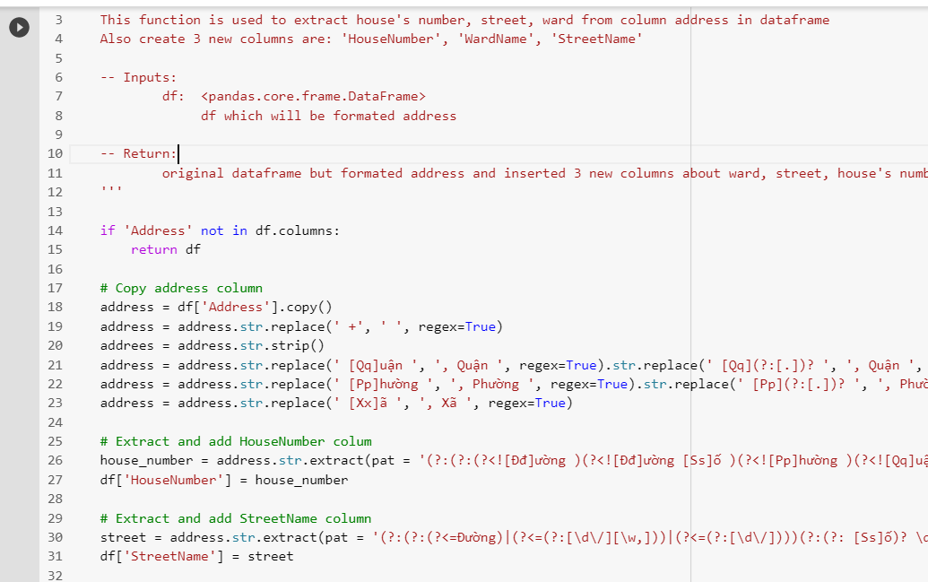
Understanding and Pre-Processing Data
Library in Python
Numpy, Pandas, Re
Matplotlib, Seaborn, folium

Slide 13
Agenda
Data Sciences Overview
Real Estate project: questions to answers
Data Collection, Preparation
Insights through Data Analysis and Data Visualization
Forecasting Problems
Summary

Slide 14
Analysing & Visualisation
Basis statistics
Analysing & Visualisation to understand real estate data
#1 Trend in Posting of Category of Posting
#2 Prices in Apartment Project
#3 Graph, Maps

Slide 15
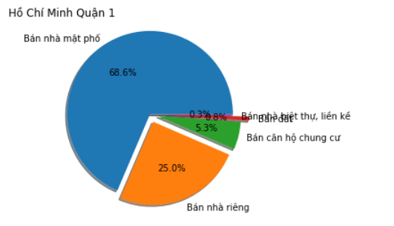
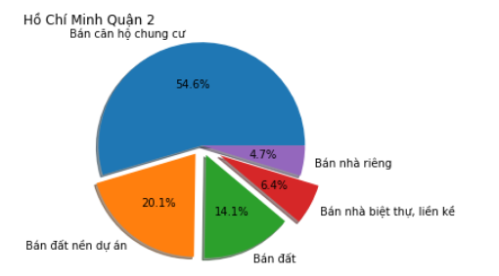
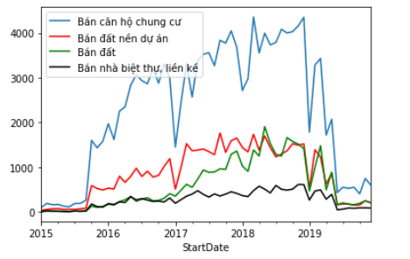
Compares Posting between districts

Slide 16
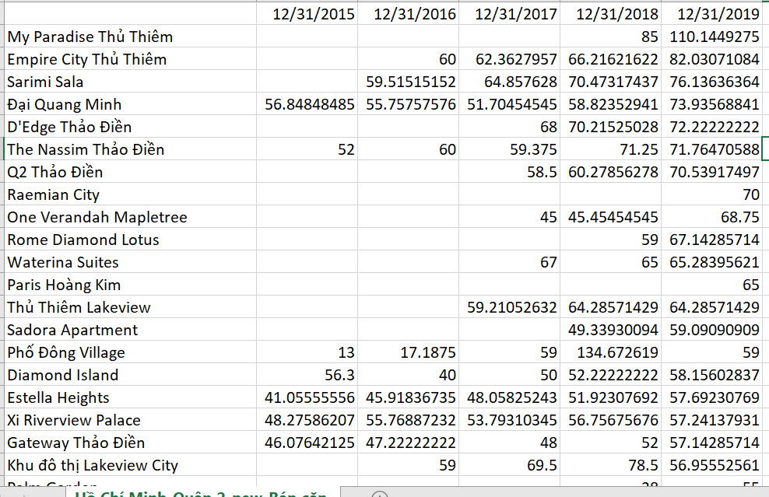
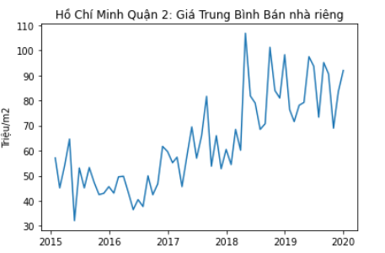
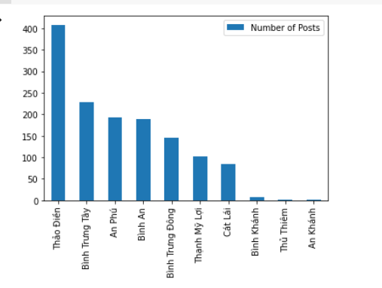
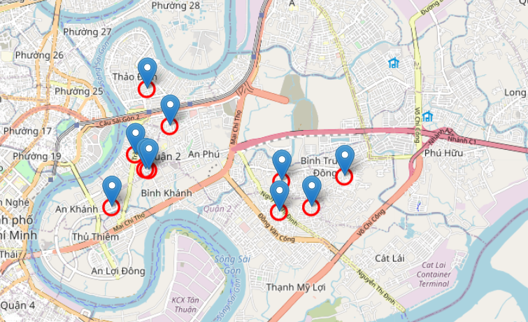
Analysis for District 2

Slide 17
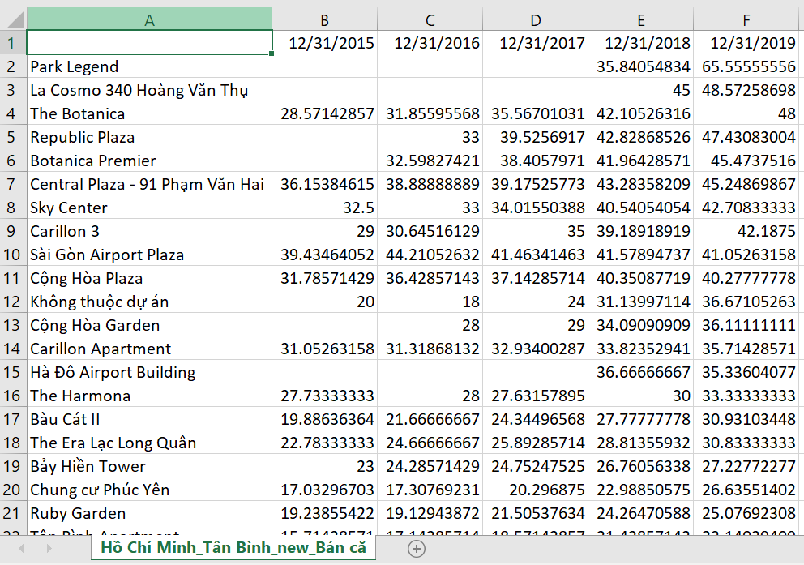
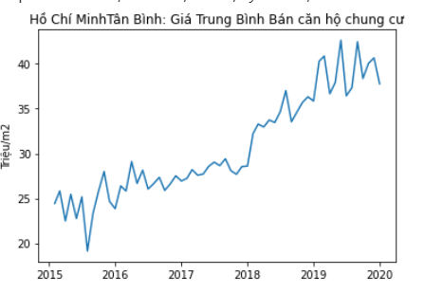
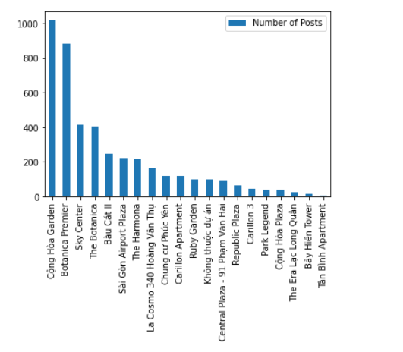
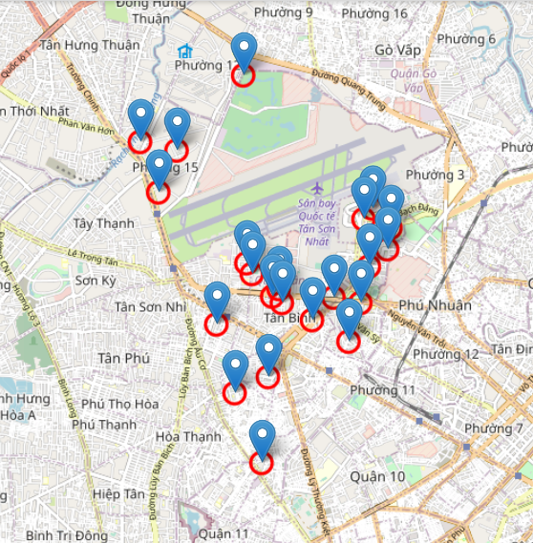
Tan Binh’s apartment project Projects

Slide 18
Agenda
Data Sciences Overview
Real Estate project: questions to answers
Data Collection, Preparation
Insights through Data Analysis and Data Visualization
Forecasting Problems
Summary

Slide 19
Forecasting Questions
Questions:
Can we forecast next month/year price of Average Apartment project ?
Can we forecast next month/year price of House in D1, D2, …Da Nang, Can Tho….. ?

Slide 20
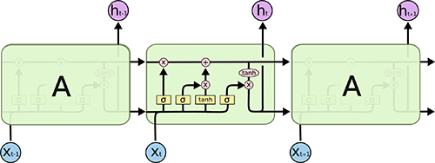
Forecasting using Deep Learning models
Deep Learning models for forecasting/ classification
Convolution networks for Image
RNN for Sequence, Time-Series
RBM, Autoencoder...
Keras as library for Deep Learning
We chosed
RNN (Recurrent Neural Network),
LSTM network for Time-Series Forecasting

Slide 21
#Forecast Time-Series using LSTM model with Keras Library
Prepare Data
Train Model
Evaluation
Forecast

Slide 22
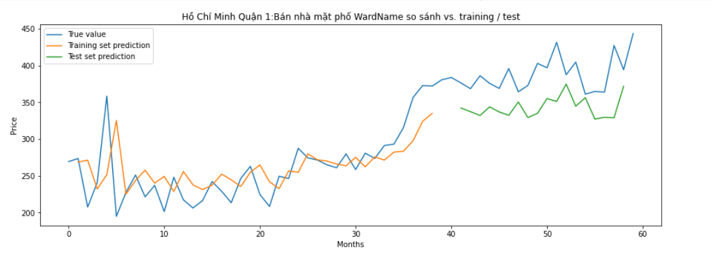

Slide 23
Agenda
Data Sciences Overview
Real Estate project: questions to answers
Data Collection, Preparation
Insights through Data Analysis and Data Visualization
Forecasting Problems
Summary

Slide 24
Summary
Business understanding is important
Visualization helps to understand data
Many library exists for statistics, deep learning….

Slide 25
References
https://www.kaggle.com/
https://cognitiveclass.ai/
LSTM Tutorial https://www.slideshare.net/RalphSchlosser/lstm-tutorial
Make forcasts on a time series of international airline passengers https://www.kaggle.com/ternaryrealm/lstm-time-series-explorations-with-keras
Measurements of electric power consumption https://towardsdatascience.com/time-series-analysis-visualization-forecasting-with-lstm-77a905180eba
monthly number of sales of shampoo over a 3-year period https://machinelearningmastery.com/tune-lstm-hyperparameters-keras-time-series-forecasting/
International Airline Passengers time-series prediction problem https://machinelearningmastery.com/time-series-prediction-lstm-recurrent-neural-networks-python-keras/

Slide 26
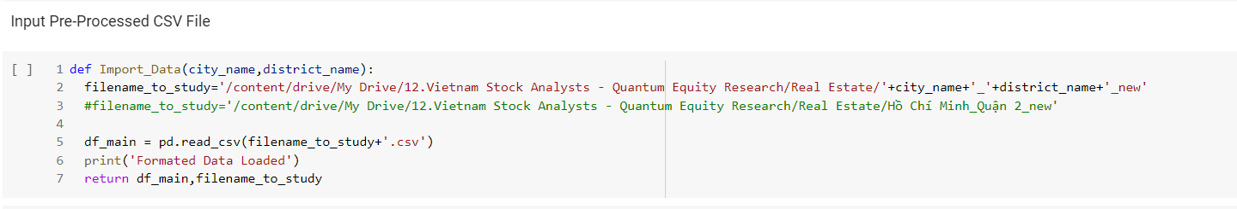
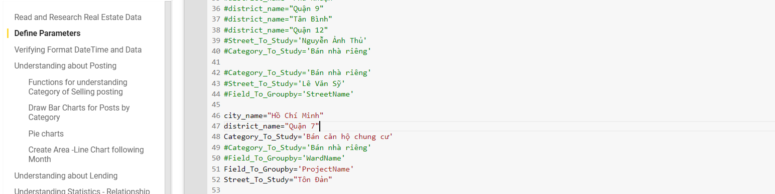
Instruction to run code
Unzip data file Hồ Chí Minh_Quận 7.zip to local server – or upload to colab
Change path to local server – or google drive (if data is put in google drive)
In Define Parameters, changes category_to_study

